Slide 1

Orders and Trades in the Market
Understanding the difference between orders and trades is fundamental to successful market participation. Orders represent instructions given to a brokerage platform, while trades are the actual execution of those instructions, resulting in the buying or selling of assets.
by Anoop Mohanty
AM

Slide 2

Market Order
A market order is an instruction to buy or sell an asset at the best available price in the market. It's the simplest order type, offering quick execution, but the price is not guaranteed.
1
Advantages
2
Disadvantages
Fastest execution, certainty of filling the order, suitability for time-sensitive trades.
No control over the price, potential for slippage, not recommended for volatile markets.

Slide 3
Limit Order
A limit order allows you to specify the maximum price you're willing to pay (buy order) or the minimum price you're willing to receive (sell order). This gives you control over the price but may not be filled if the market price doesn't reach your limit.
Advantages
Disadvantages
Price control, reduces slippage risk, suitable for specific price targets.
May not be filled, less likely to be executed in volatile markets, potential for delayed execution.

Slide 4

Stop Loss Order
A stop loss order is designed to limit potential losses on an existing position. It automatically triggers a market order to sell your asset when the price reaches a predetermined stop price.
1
Purpose
Minimize losses when the price of an asset falls unexpectedly.
2
Mechanism
Once the stop price is hit, a market order to sell is triggered, limiting potential further losses.
3
Note
Stop loss orders don't guarantee a specific sale price. The market order will be filled at the best available price when triggered.

Slide 5
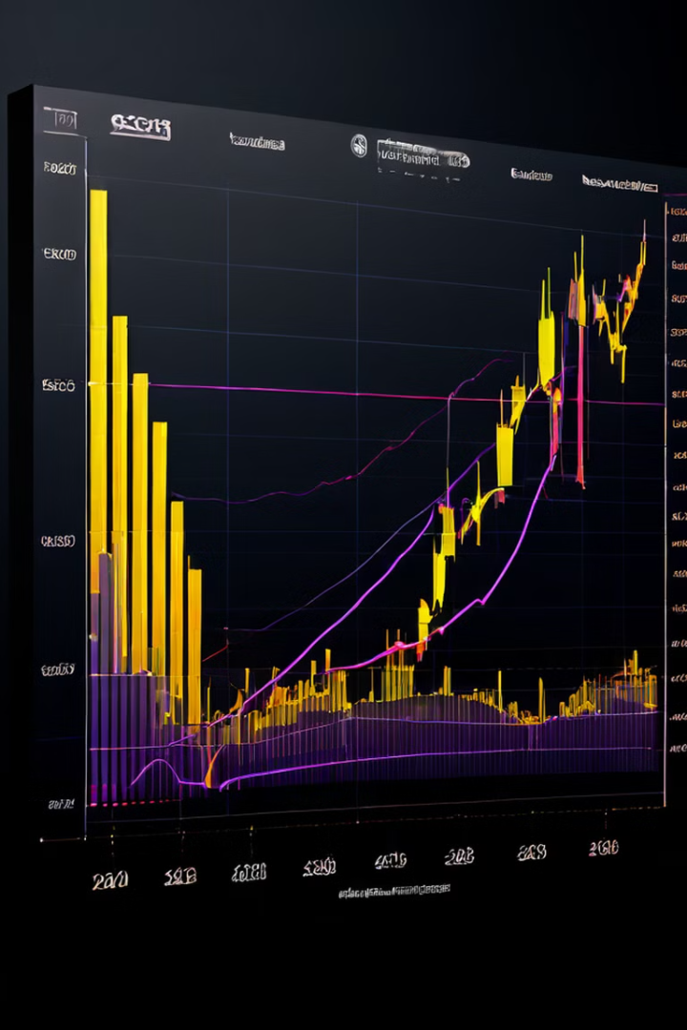



Stop Loss Market Order
A stop loss market order combines the features of a stop loss order and a market order. When the stop price is reached, it triggers a market order to sell the asset at the best available price in the market.
Trigger
When the stop price is reached.
Execution
Immediate execution of a market order at the best available price.
Risk
No control over the execution price, possible slippage.

Slide 6

Good-Till-Canceled (GTC) Order
A GTC order remains active until it is either filled, canceled by the user, or the order is expired by the broker due to the asset being delisted or reaching its expiration date.
Advantage
Disadvantage
Convenient for long-term trades, ensuring the order remains active until filled.
Requires monitoring in case of significant market changes or asset delisting.

Slide 7
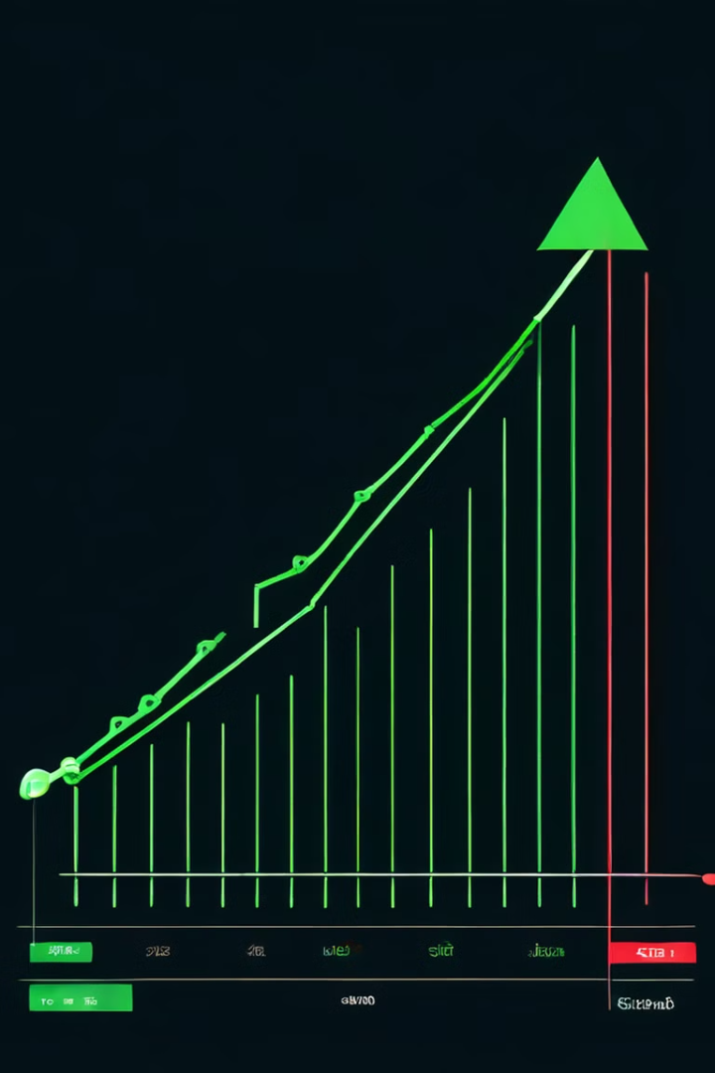
Immediate-or-Cancel (IOC) Order
An IOC order attempts to fill the entire order immediately. If the entire order cannot be filled at the current market price, any unfilled portion is automatically canceled.
Filled
Entire order is executed at the best available price.
Partially Filled
A portion of the order is filled at the best available price, and the remaining portion is canceled.
Unfilled
The entire order is canceled as it cannot be filled at the current market price.

Slide 8




After-Market Order
An after-market order allows you to place an order to buy or sell an asset after the regular trading hours have ended. These orders are executed during the post-market session, which typically occurs from 4:00 PM to 8:00 PM ET.
Post-Market
Orders executed during the post-market session, typically after the regular trading hours.
Price Volatility
Potential for higher price volatility and slippage due to limited liquidity.
Limited Liquidity
Fewer market participants available, resulting in smaller trading volumes and potential for wider spreads.

Slide 9
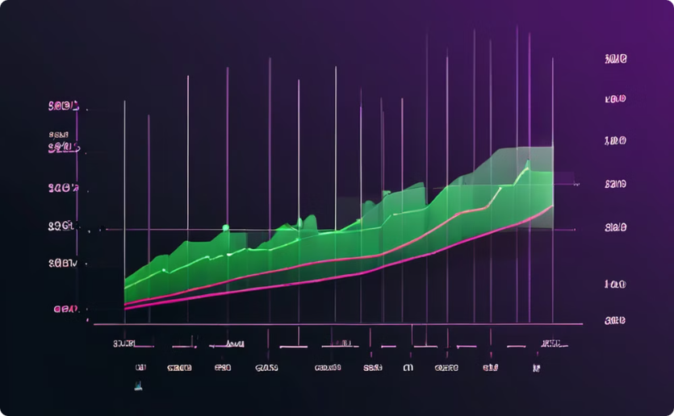
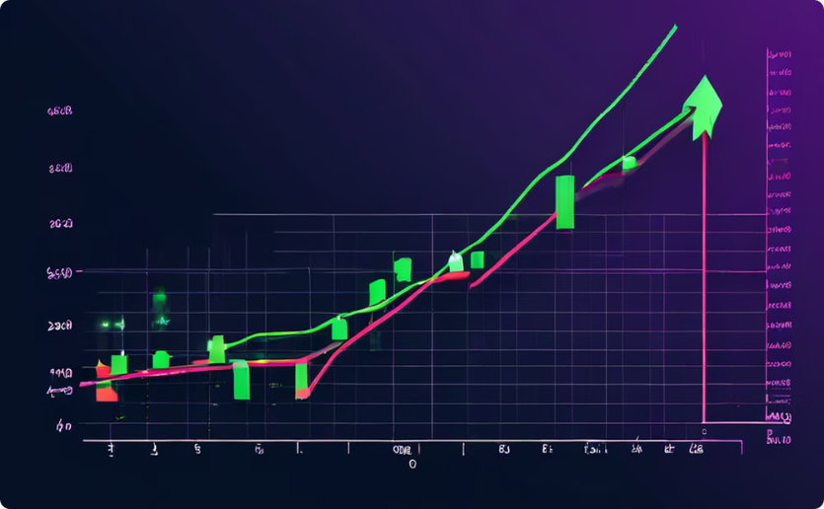
Good-Till-Time (GTT) Order
A GTT order allows you to specify a specific time when the order should be filled. The order will remain active until that time is reached, and then it will be canceled if it has not been filled.
Time Constraint
Conditional Execution
The order is valid only until the specified time.
The order will be executed only if the price reaches the target price before the specified time.

Slide 10

Margin Trading and Basket Trading
Margin trading involves borrowing funds from a broker to increase your buying power. Basket trading refers to the simultaneous purchase or sale of multiple assets in a single order. Understanding these concepts requires advanced market knowledge and can significantly impact your trading strategy.
1
Margin Trading
2
Basket Trading
Leveraged trading, increased risk and potential return.
Diversification, potentially reducing risk and improving portfolio performance.

